Slide 1
Basic Communication
v1-6
Communication in Distributed Systems

Slide 2
Marshalling
CORBA (1991) Common Request Broker
Java object serialization
XML Extensible Markup Language
v1-6
Communication in Distributed Systems

Slide 3
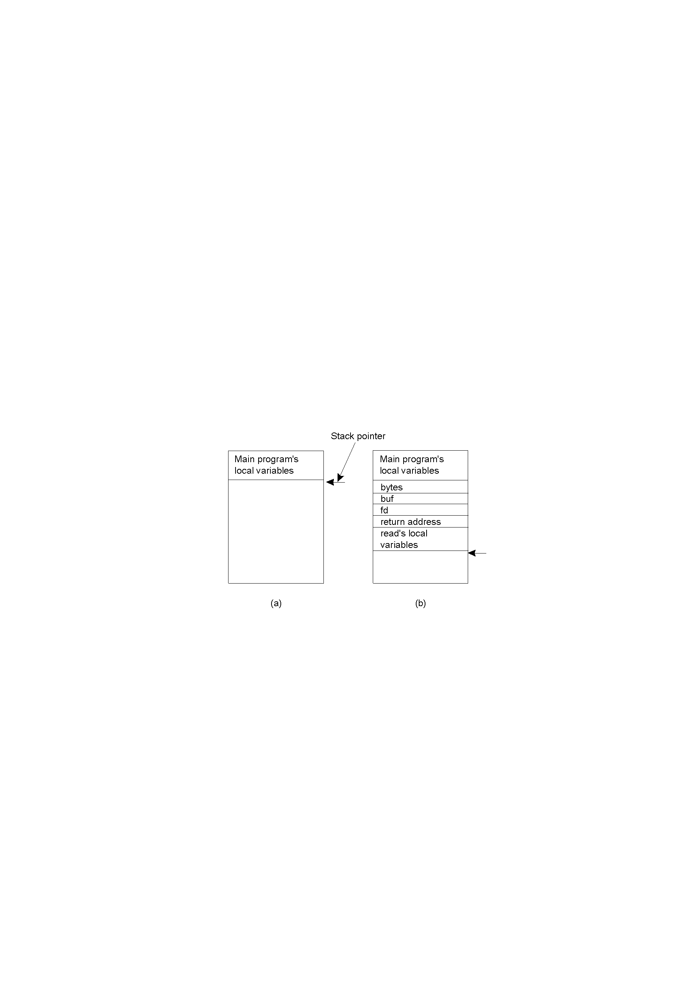
Conventional Procedure Call
Parameter passing in a local procedure call: the stack before the call to read
The stack while the called procedure is active
v1-6
Communication in Distributed Systems

Slide 4
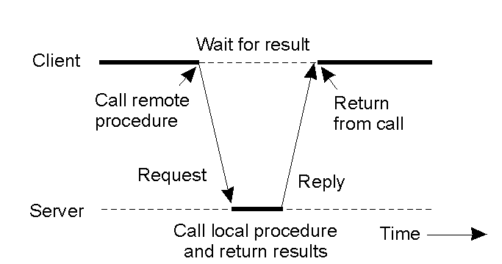
Client and Server Stubs
Principle of RPC between a client and server program.
v1-6
Communication in Distributed Systems

Slide 5
Remote Procedure Call(1)
Mimic’s a local procedure call except the call is executed on another machine.
Parameters are put into network packets and sent to a server machine where the called function is executed.
The results are returned in a network packet that is sent back to the client machine.
v1-6
Communication in Distributed Systems

Slide 6
Remote Procedure Call(2)
Issues that need to be considered include:
  Response time (can be considerable)
  Error handling due to comunication delays
  Parameter incompatability between different computers
    EBCDIC vs ASCII
    Various floating point formats
    Big-endian vs Little-endian
    Basic variable types in different languages
    Call by reference parameters (e.g. pointers)
v1-6
Communication in Distributed Systems

Slide 7
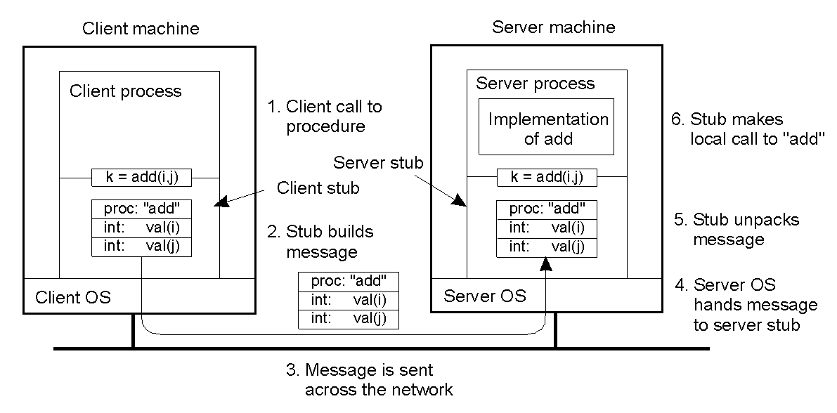
Passing Value Parameters (1)
2-8
Steps involved in doing remote computation through RPC
v1-6
Communication in Distributed Systems

Slide 8

Passing Value Parameters (2)
Original message on the Pentium
The message after receipt on the SPARC
The message after being inverted. The little numbers in boxes indicate the address of each byte
v1-6
Communication in Distributed Systems

Slide 9
Questions
1) C has a structure called a union - Does this feature cause problems in RPC’s?
2) One way to handle parameter conversion in RPC systems is to have each machine send parameters in its native representation with the receiver doing the translation. Are there any issues with this approach?
v1-6
Communication in Distributed Systems

Slide 10
Passing Reference Parameters
How are pointers/references passed?
Arrays
  Copy the array into the message
  For efficiency tag it as input or output
  Specify its current and maximum size
  arrayfoo ( in max_is, inout cur_is,
  inout int array[]);
Dynamic Data Structures
  Linearize e.g. convert binary tree to an array of structures
v1-6
Communication in Distributed Systems

Slide 11

Parameter Specification and Stub Generation
A procedure
The corresponding message.
v1-6
Communication in Distributed Systems

Slide 12
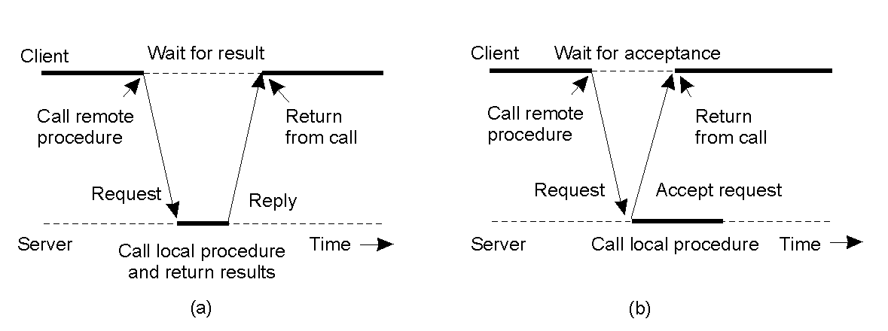
Asynchronous RPC (1)
2-12
The interconnection between client and server in a traditional RPC
The interaction using asynchronous RPC
v1-6
Communication in Distributed Systems

Slide 13
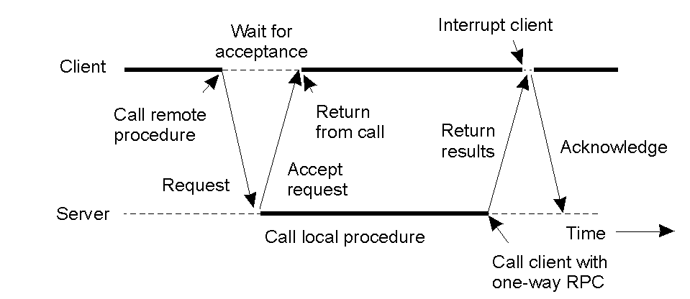
Asynchronous RPC (2)
2-13
A client and server interacting through two asynchronous RPCs
v1-6
Communication in Distributed Systems

Slide 14
OSF Distributed Computing Environment
OSF founded by Hewlett-Packard, IBM and Digital
Produces specifications and reference platforms
Subsumed into the Open Group
DCE RPC typical of many RPC systems, specifications adopted by Microsoft
True middleware, sits between NOS and application
Ported to Unix, VMS and Windows NT
v1-6
Communication in Distributed Systems

Slide 15
Interface Definition Language
{ UUID (1234567-222-3333-4444-1234567ABC) }
interface matrix
{
void MatrixAdd(in matrix_t a, in matrix_t b,
out matrix_t result);
void MatrixInvert(in matrix_t a,
out matrix_t result);
void MatrixMult(in matrix_t a, in matrix_t b,
matrix_t out result);
}
v1-6
Communication in Distributed Systems

Slide 16
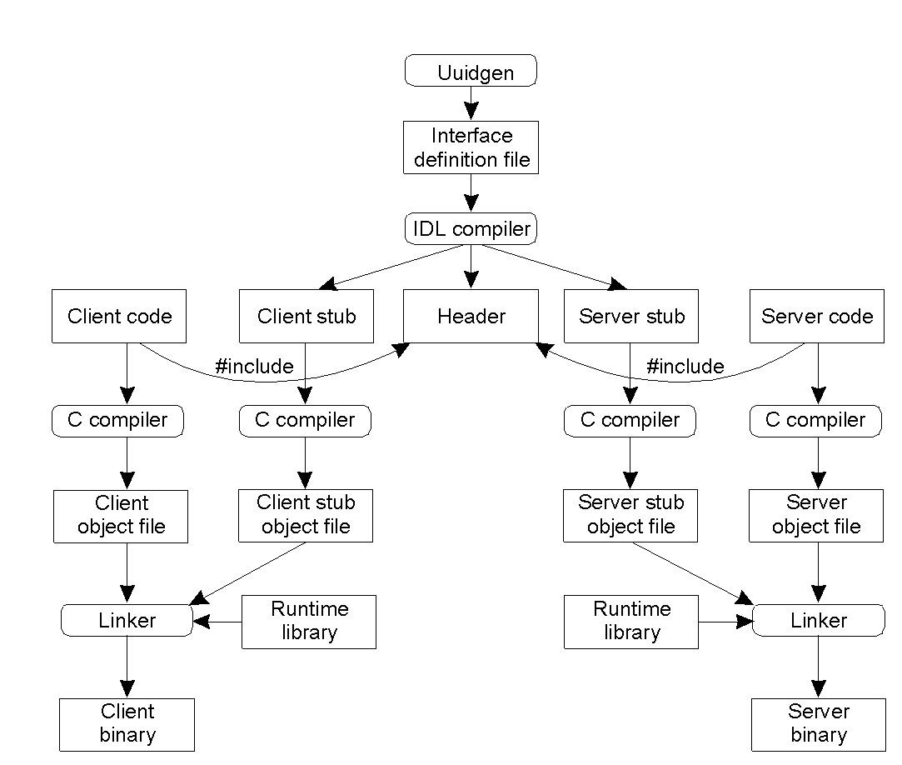
Writing a Client and a Server
2-14
The steps in writing a client and a server in DCE RPC.
v1-6
Communication in Distributed Systems

Slide 17
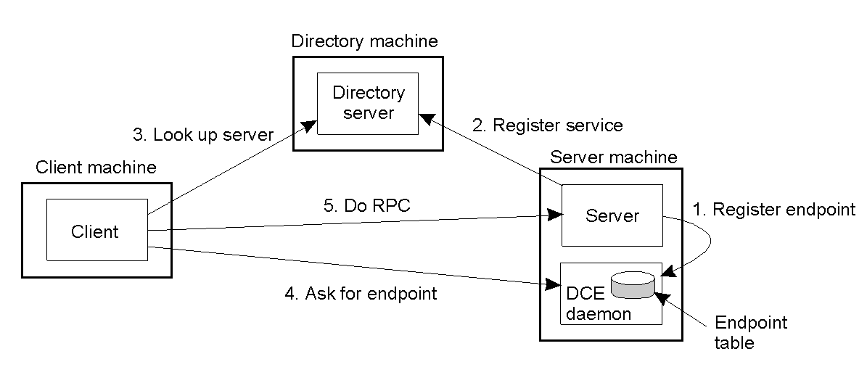
Binding a Client to a Server
2-15
Client-to-server binding in DCE.
v1-6
Communication in Distributed Systems

